Slide 1
Itf – Ryanair campaign

Slide 2
How do lccs work?
Lowest possible cost = Lowest possible fare
Profits come from cost savings:
Reduced cost of workforce
Fuel hedging
Bulk aircraft buying
Single aircraft fleet
Taxation
Airport Subsidies
These activities force other carriers to do the same in order to drive costs down

Slide 3
Life as Ryanair cabin crew (Pre-campaign)
No Water
No Food
No access to local bank account – Access to loans and mortgages
No access to social welfare payments or healthcare in 31 of 33 countries
No Sick Pay
Meet managers to prove you are sick
Paid for ‘chock to chock’ only. No pay for boarding, briefing, delays
Promotions, based transfers and dismissals all based on sales

Slide 4
Campaign milestones
ECJ rules against Ryanair on National Law (2017)
First unions achieve recognition (Spring/Summer 2018)
Ryanair Crew Summit creates Ryanair Crew Charter (June 2018)
Cabin Crew and Pilots Strikes (2018)
More recognition and first CLAs (Autumn 2018)
Ryanair AGM – ITF/ETF calls for reforms (September 2018)

Slide 5
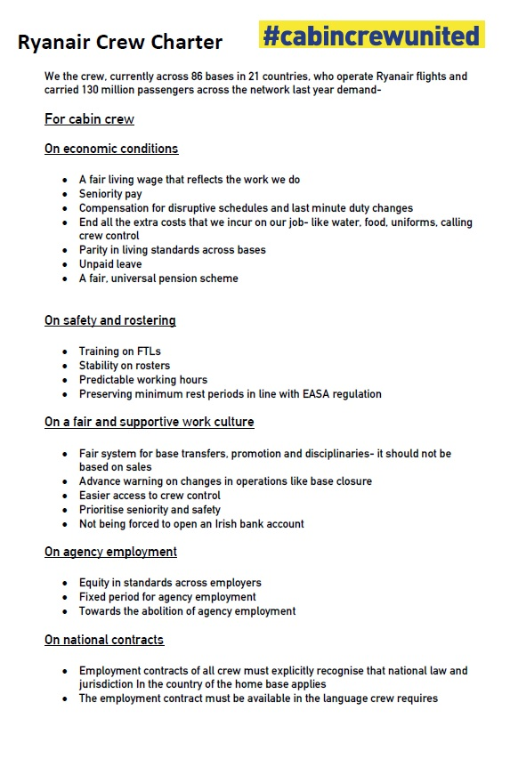
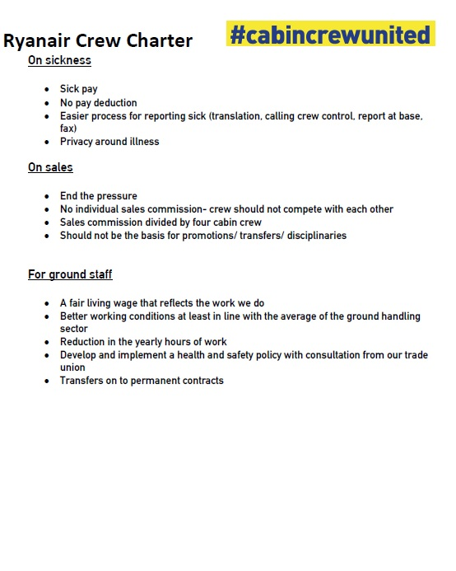
Ryanair crew charter
Notes:
34 demands for Ryanair to consider on:
Economic Conditions
Safety and Rostering
Fair and Supportive Work Culture
Agency Employment
National Contracts
Sickness
Sales
Ground Staff
Ryanair dismissed the charter as ‘pointless’

Slide 6
Challenges
National Jurisdiction and Laws – Company applied Irish law unilaterally – Ignoring domestic law
Size of company – 10,000+ pilots and cabin crew
Staff Turnover – Average 1-3 years
Spread of workers – Across 85 bases (and growing)
Massive number of bargaining units
Ryanair’s inexperience in Industrial Relations

Slide 7
Contact us: Email: civilaviation@itf.org.uk www.itfaglobal.org

